Slide 1

DATA STRUCTURES USING C
22BCA2C05
Module 2

Slide 2


Slide 3
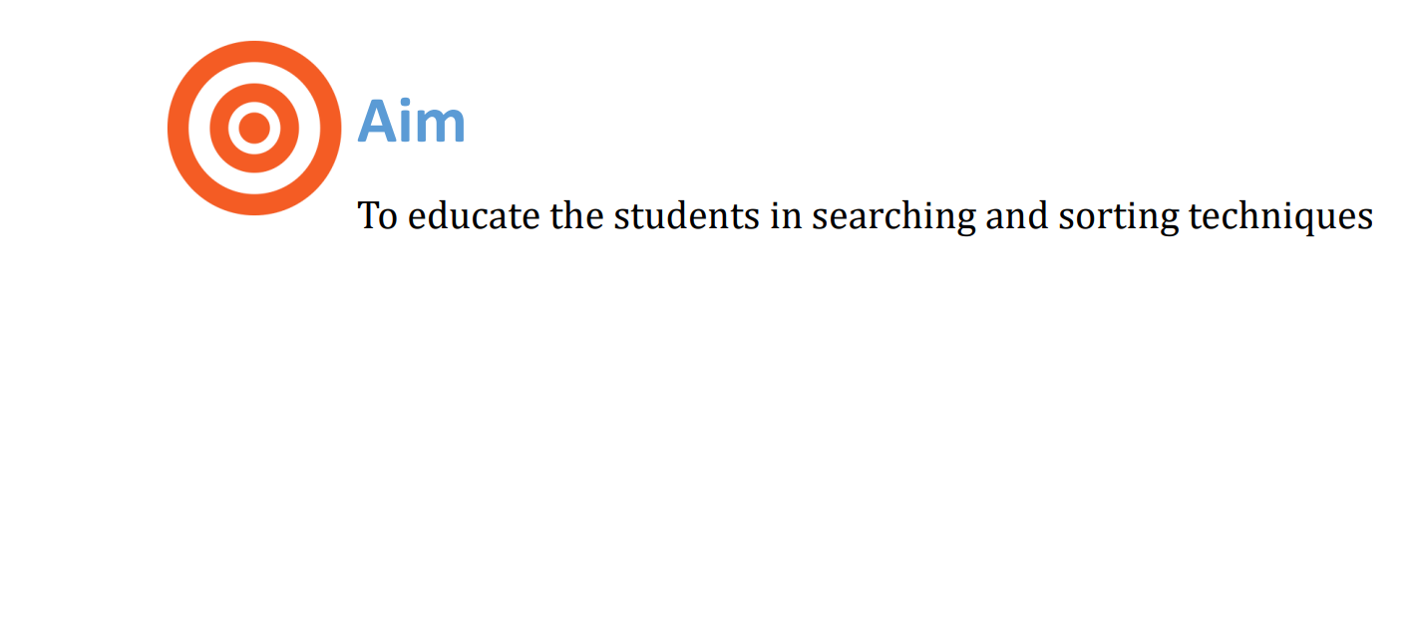

Slide 4
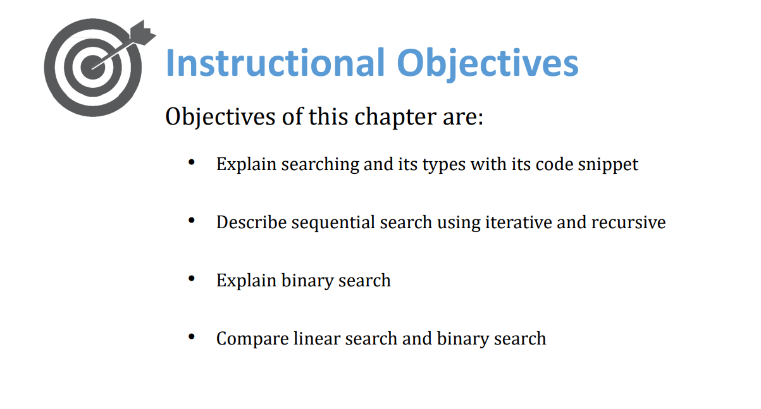

Slide 5


Slide 6


Slide 7
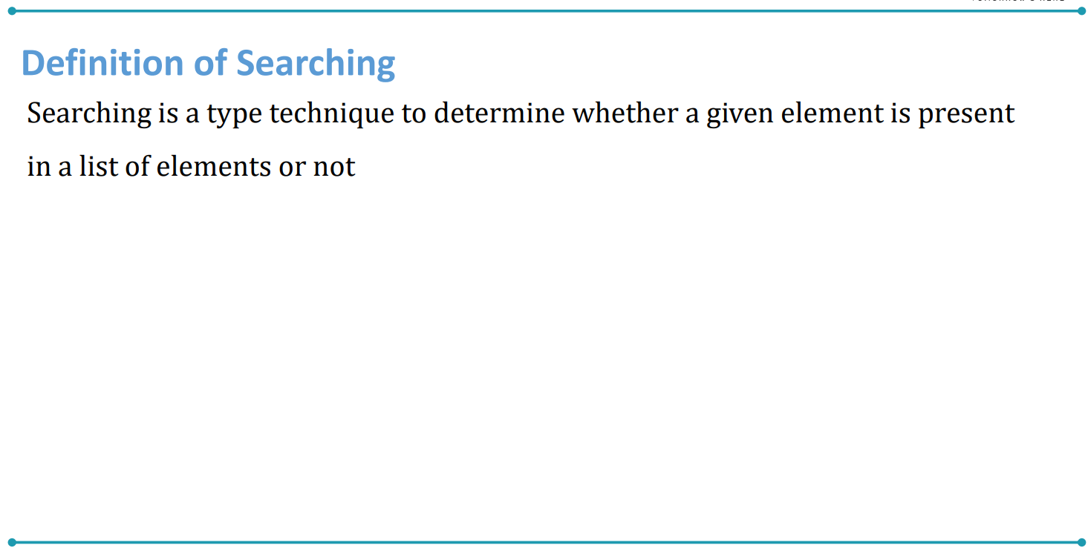

Slide 8
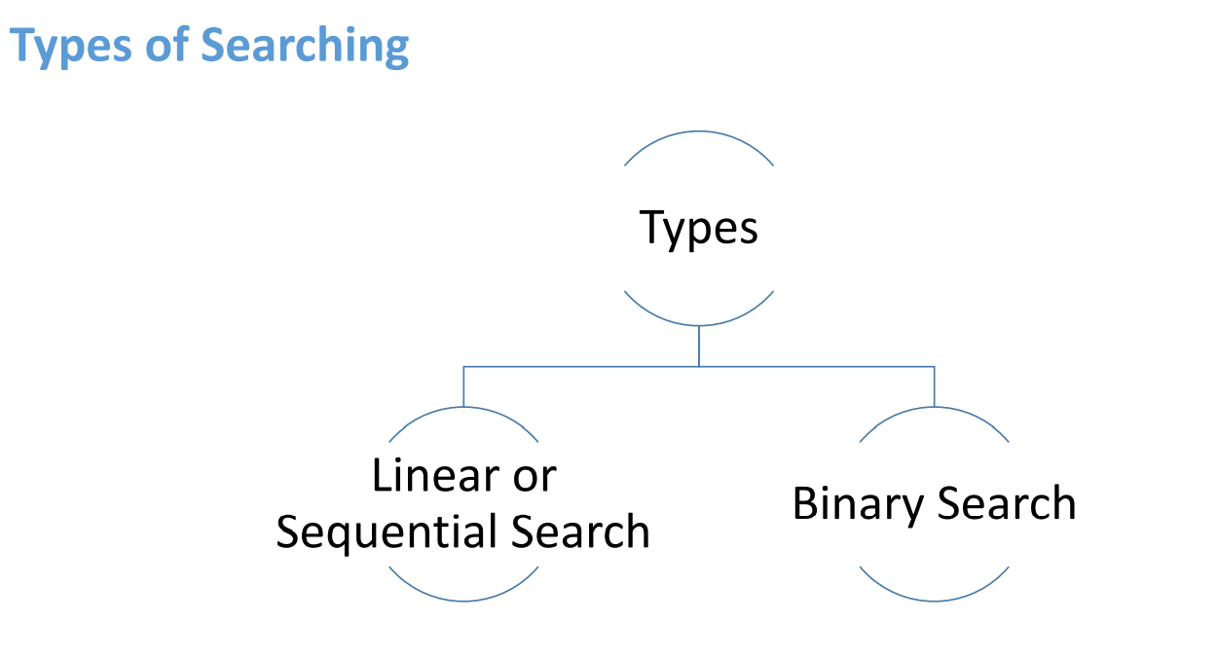

Slide 9

Linear Search Algorithm

Slide 10
Searching is the process of finding some particular element in the list. If the element is present in the list, then the process is called successful, and the process returns the location of that element; otherwise, the search is called unsuccessful.
Linear search is also called a sequential search algorithm.
It is the simplest searching algorithm.
In Linear search, we simply traverse the list completely and match each element of the list with the item whose location is to be found.

Slide 11
What is Linear search?
Linear Search is an algorithm that starts at one end and goes through each element of a list until the desired element is found, otherwise the search continues till the end of the data set. It is the easiest search algorithm

Slide 12
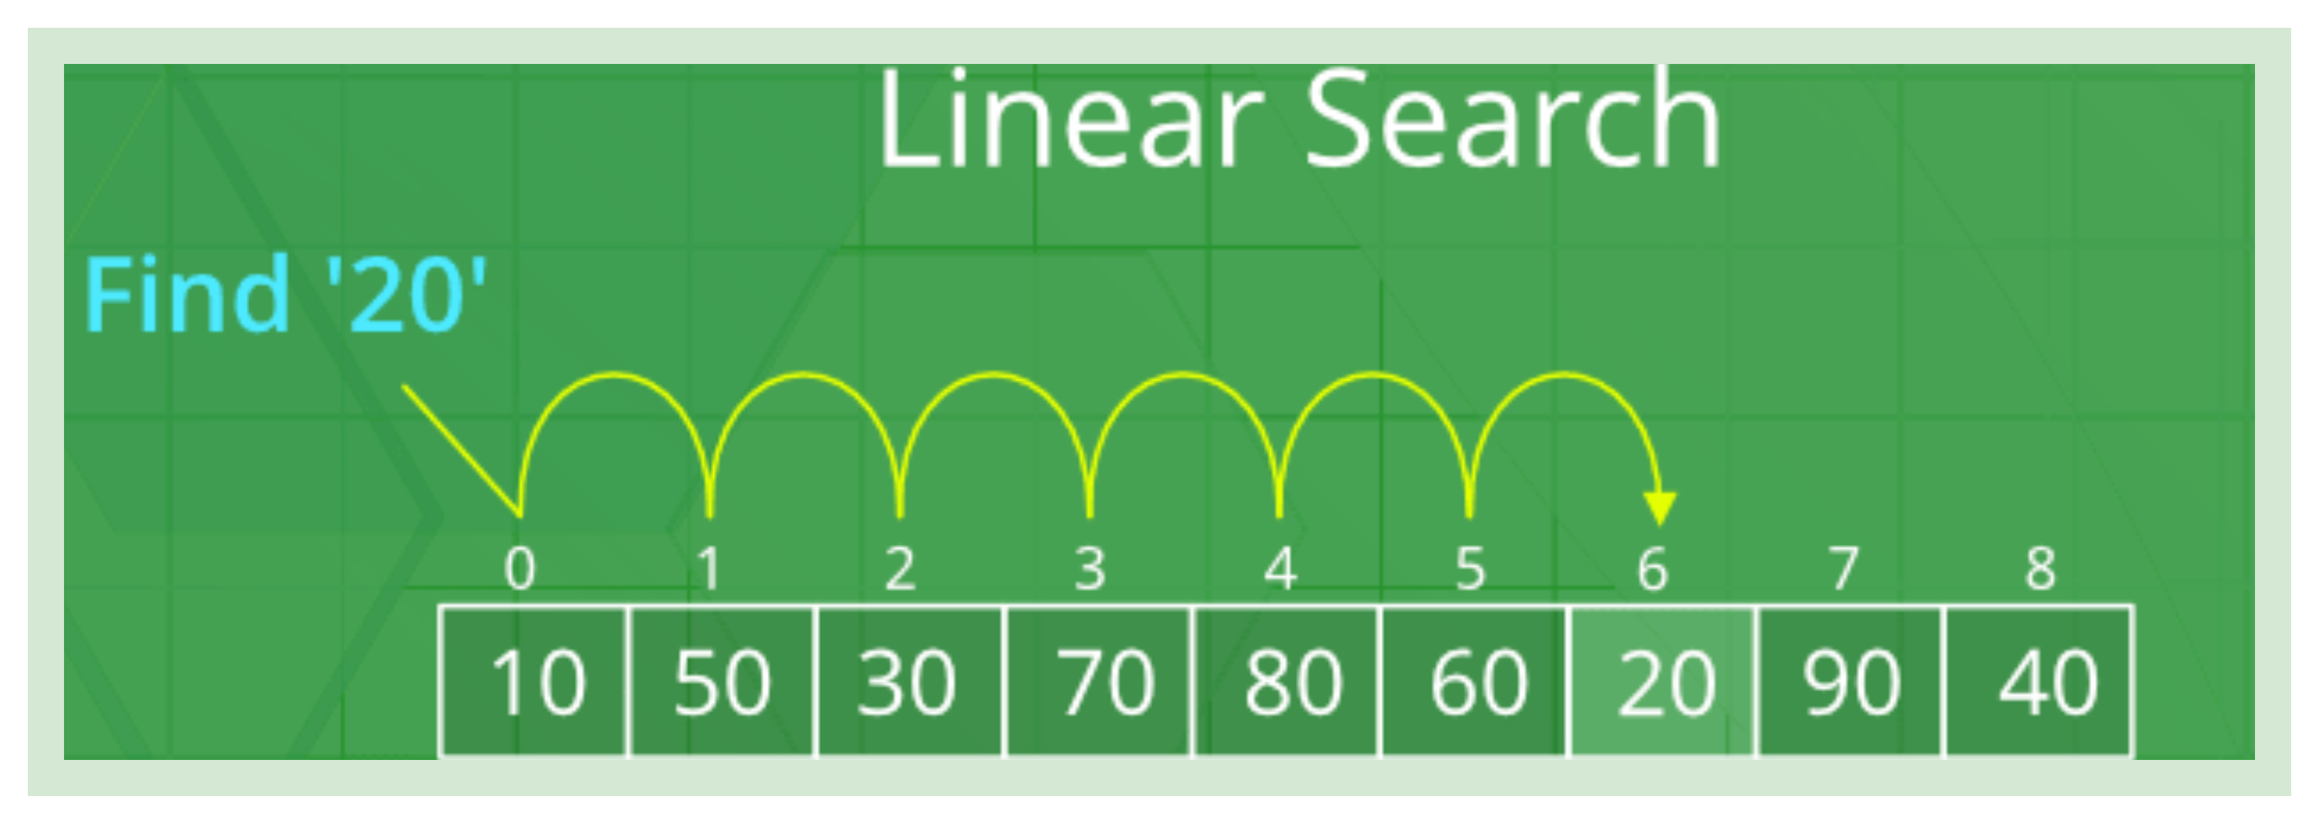
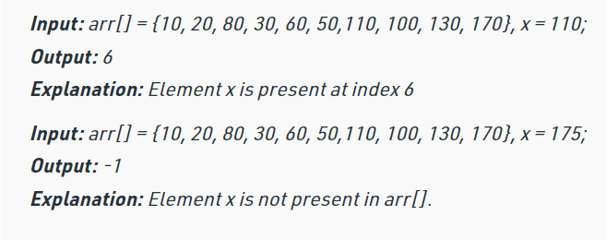
Working algorithm of Linear search:
Notes:
#include <stdio.h>int main(){ int array[50], position, c, n, value; printf("Enter number of elements in the array\n"); scanf("%d", &n); printf("Enter %d elements\n", n); for (c = 0; c < n; c++) scanf("%d", &array[c]); printf("Please enter the location where you want to insert an new element\n"); scanf("%d", &position); printf("Please enter the value\n"); scanf("%d", &value); for (c = n - 1; c >= position - 1; c--) array[c+1] = array[c]; array[position-1] = value; printf("Resultant array is\n"); for (c = 0; c <= n; c++) printf("%d\n", array[c]); return 0;}

Slide 13
Algorithm
Linear_Search(a, n, val) // 'a' is the given array, 'n' is the size of given array, 'val' is the value to search
8. go to step 6
9. [end of if]
10. set i = i + 1
11. [end of loop]
12. Step 5: if pos = -1
13. print "value is not present in the array "
14. [end of if]
15. Step 6: exit
Step 1: set pos = -1
Step 2: set i = 1
Step 3: repeat step 4 while i <= n
Step 4: if a[i] == val
set pos = i
print pos

Slide 14
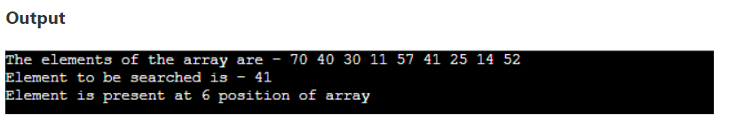
#include <stdio.h>
int linearSearch(int a[], int n, int val) {
// Going through array sequentially
for (int i = 0; i < n; i++)
{
if (a[i] == val)
return i+1;
}
return -1;
}
int main() {
int a[] = {70, 40, 30, 11, 57, 41, 25, 14, 52}; // given array
int val = 41; // value to be searched
int n = sizeof(a) / sizeof(a[0]); // size of array
int res = linearSearch(a, n, val); // Store result
printf("The elements of the array are - ");
for (int i = 0; i < n; i++)
printf("%d ", a[i]);
printf("\nElement to be searched is - %d", val);
if (res == -1)
printf("\nElement is not present in the array");
else
printf("\nElement is present at %d position of array", res);
return 0; }

Slide 15



Slide 16
Binary search is the search technique that works efficiently on sorted lists.
Hence, to search an element into some list using the binary search technique, we must ensure that the list is sorted.
Binary search follows the divide and conquer approach in which the list is divided into two halves, and the item is compared with the middle element of the list.
If the match is found then, the location of the middle element is returned.
Otherwise, we search into either of the halves depending upon the result produced through the match.

Slide 17
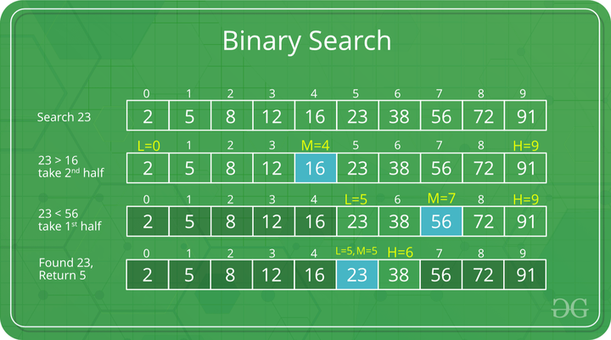
Working algorithm of Binary search:
Binary Search is a searching algorithm used in a sorted array by repeatedly dividing the search interval in half.

Slide 18
Algorithm
Binary_Search(a, lower_bound, upper_bound, val)
// 'a' is the given array, 'lower_bound' is the index of the first array element, 'upper_bound' is the index of the last array element, 'val' is the value to search
else if a[mid] > val
set end = mid - 1
else set beg = mid + 1
[end of if]
[end of loop]
Step 5: if pos = -1
print "value is not present in the array"
[end of if]
Step 6: exit
Step 1: set beg = lower_bound, end = upper_bound, pos = - 1
Step 2: repeat steps 3 and 4 while beg <=end
Step 3: set mid = (beg + end)/2
Step 4: if a[mid] = val
set pos = mid
print pos
go to step 6

Slide 19
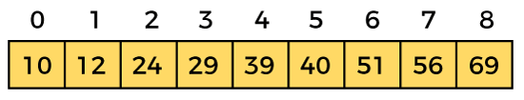
Working of Binary search
Let the elements of array are -
Let the element to search is, K = 56
We have to use the below formula to calculate the mid of the array -
mid = (beg + end)/2
beg = 0
end = 8
mid = (0 + 8)/2 = 4. So, 4 is the mid of the array.

Slide 20
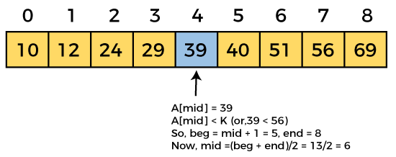
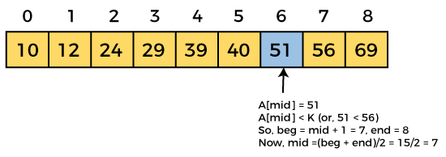
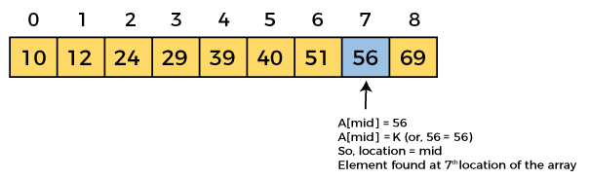
K = 56
Now, the element to search is found. So algorithm will return the index of the element matched.

Slide 21
#include <stdio.h>
int binarySearch(int a[], int beg, int end, int val)
{
int mid;
if(end >= beg)
{ mid = (beg + end)/2;
if(a[mid] == val)
{
return mid+1;
}
else if(a[mid] < val)
{
return binarySearch(a, mid+1, end, val);
}
else
{ return binarySearch(a, beg, mid-1, val); } }
return -1; }
int main() {
int a[] = {11, 14, 25, 30, 40, 41, 52, 57}; // given array
int val = 40; // value to be searched
int n = sizeof(a) / sizeof(a[0]); // size of array
int res = binarySearch(a, 0, n-1, val); // Store result
printf("The elements of the array are - ");
for (int i = 0; i < n; i++)
printf("%d ", a[i]);
printf("\nElement to be searched is - %d", val);
if (res == -1)
printf("\nElement is not present in the array");
else
printf("\nElement is present at %d position of array", res);
return 0;
}

Slide 22
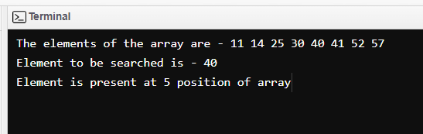
Output

Slide 23
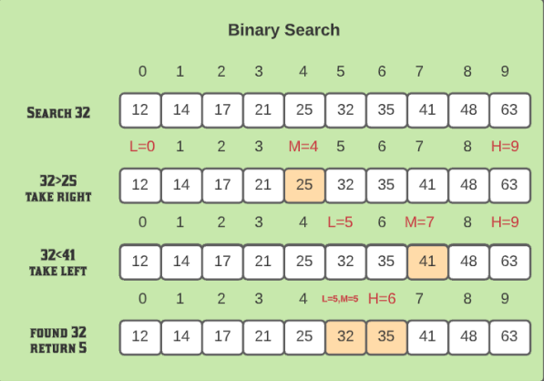

Slide 24
Thank you

